Slide 1
Hacker101 CTF Micro-CMS v1

Slide 2
CTF Report Structure for Micro-CMS v1
Title and Basic Information
Objective
Environment Setup
Methodology and Approach
Detailed Walkthrough
Challenges Faced and Solutions
Tools Used
Lessons Learned
Conclusion
References

Slide 3
Title and Basic Information
Title: Micro-CMS v1 Capture the Flag Walkthrough
Author: ALi Lotfy
Date: [14/10/2024]
Challenge Difficulty: Easy
Skills: Web Application Security

Slide 4
Objective
The goal of the Micro-CMS v1 CTF challenge is to exploit vulnerabilities in a web-based content management system to gain access and capture the flag. The challenge focuses on web application vulnerabilities such as SQL Injection and improper access controls.

Slide 5
3. Environment Setup
Environment Setup:
- Platform: Hack The Box
- Target: Micro-CMS v1 web application
- My System: Kali Linux 2023.3
- Tools Used: Nmap, SQLMap, Browser (Firefox), and the terminal.

Slide 6
4. Methodology and Approach
1. **Reconnaissance**: Performed initial information gathering using Nmap to identify open ports and services.
2. **Enumeration**: OWASP ZAP to manually analyze web application requests and responses, searching for vulnerabilities like SQL Injection.
3. **Exploitation**: Automated the exploitation of discovered vulnerabilities using SQLMap to extract the database and gain access.
4. **Flag Capture**: Navigated through the CMS to locate and retrieve the flag.

Slide 7
5. Detailed Walkthrough

Slide 8
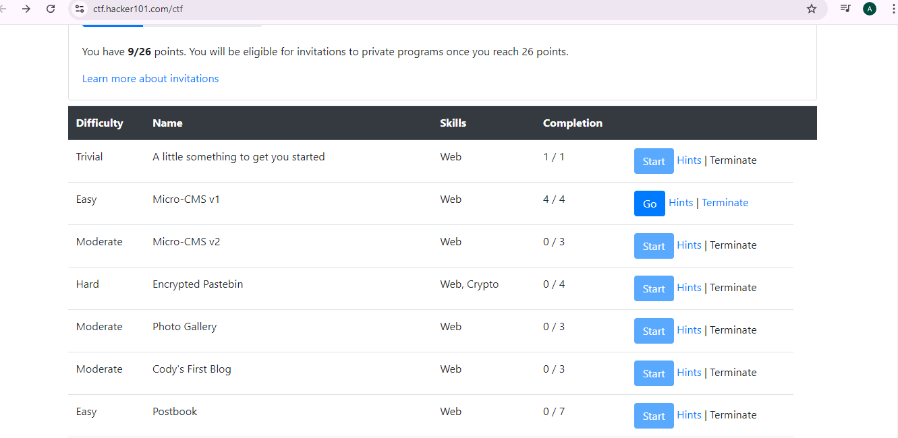
Next challenge is Micro-CMS v1

Slide 9
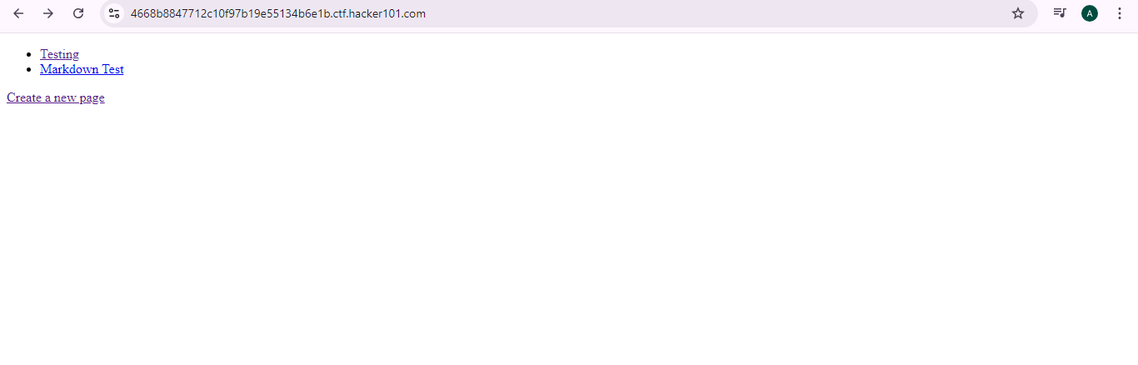
In the first page you will see Testing, Markdown Test, create a new page, lets have a look and start click on Testing

Slide 10
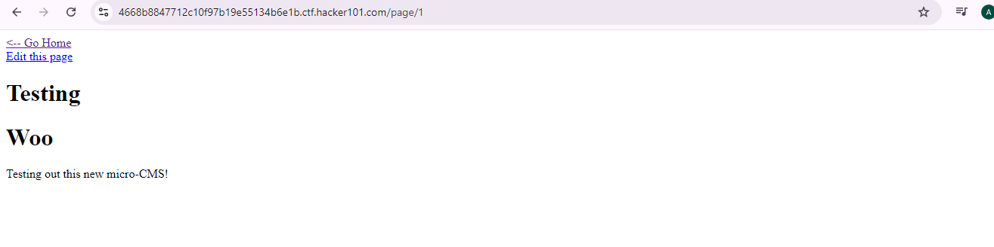
Notice Testing is already page 1 as you see in the address, click Go home

Slide 11
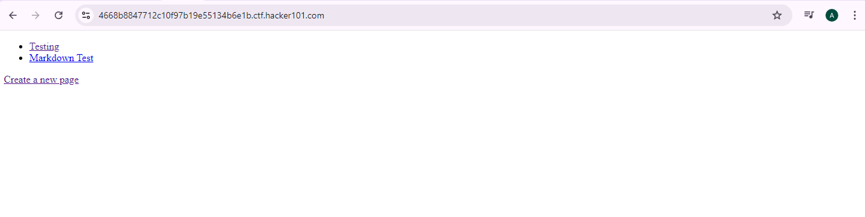
Click on Markdown Test

Slide 12
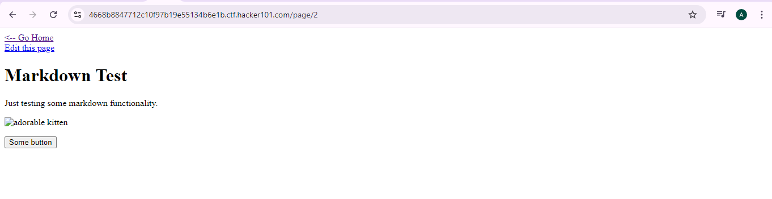
Click on some button and check if there anyting, Notice Markdown Test is already page 2 as you see in the address, then Click go Home

Slide 13
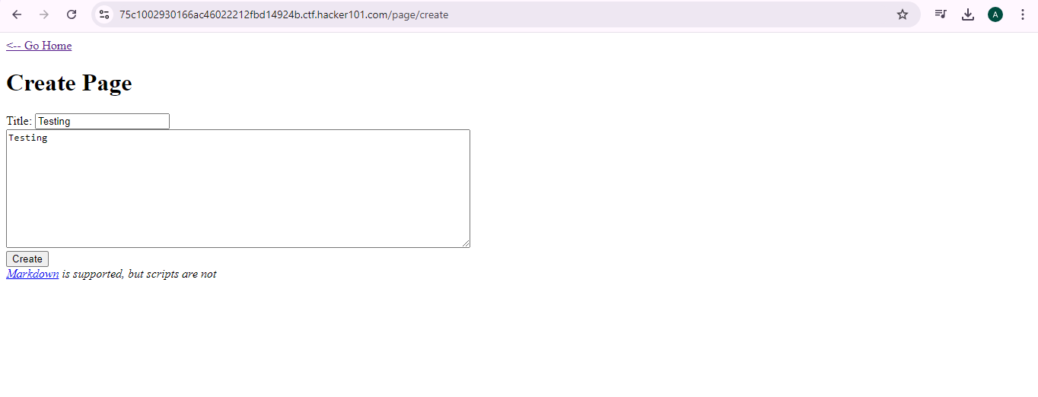
Next step click on Create a new page and write in the title a name as example write testing nad click create

Slide 14
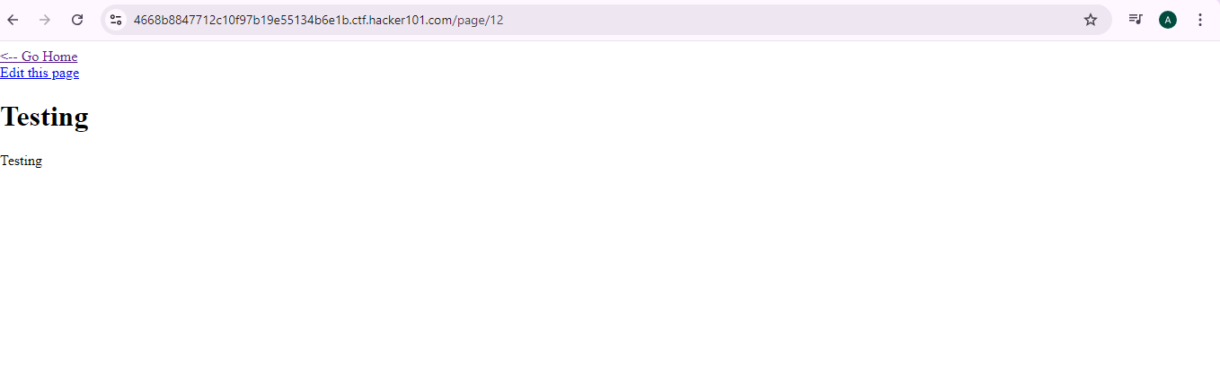
Notice that after creating the page its Number 12, it might with you can be a different number

Slide 15
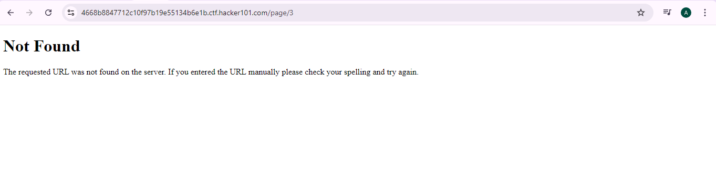
To find the flag you have to check hints each time, next step is to change page number in the address you can add ,3,4,5,6,7,8,9........ until you see the flag

Slide 16
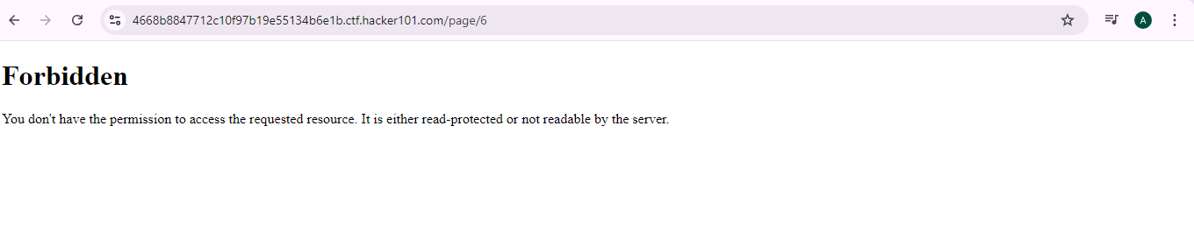
We found page number 6 is Forbidden so lets go back to the Testing page

Slide 17
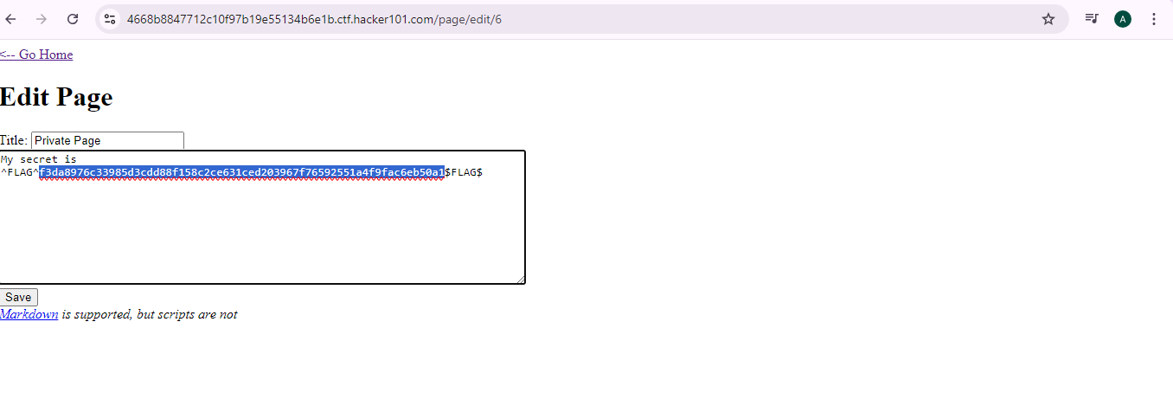
Click edit page and add number 6 in the address and then click enter , It will show you her secret it the flag copy the flag and go to the main page

Slide 18
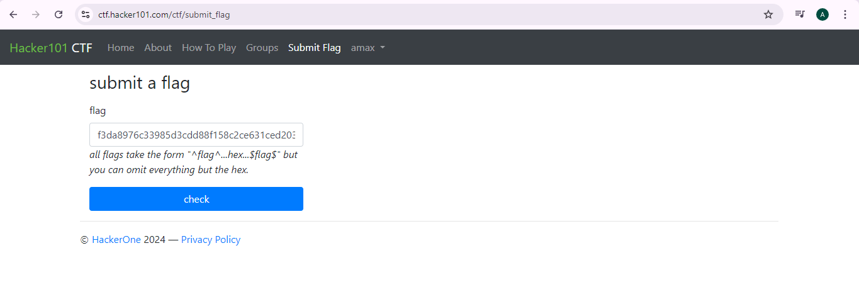
Submit the flag and copy iot and then click check

Slide 19
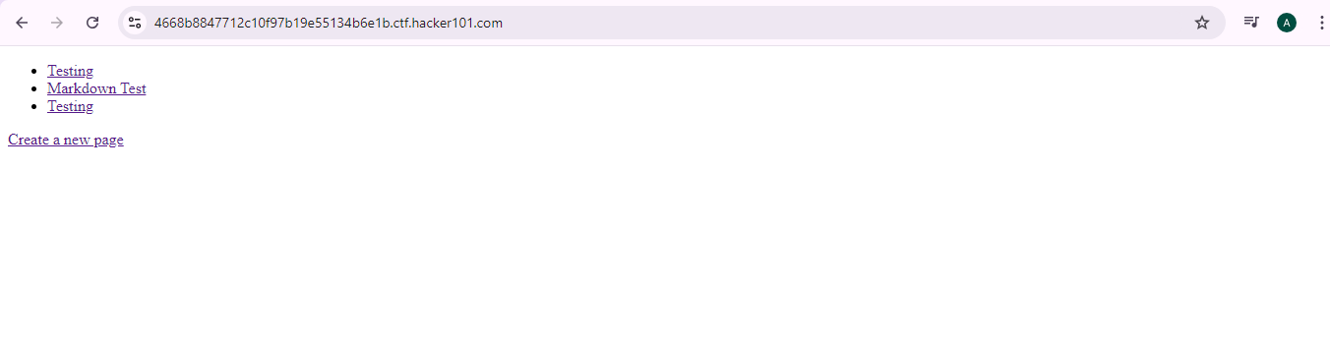
Click create a new page

Slide 20
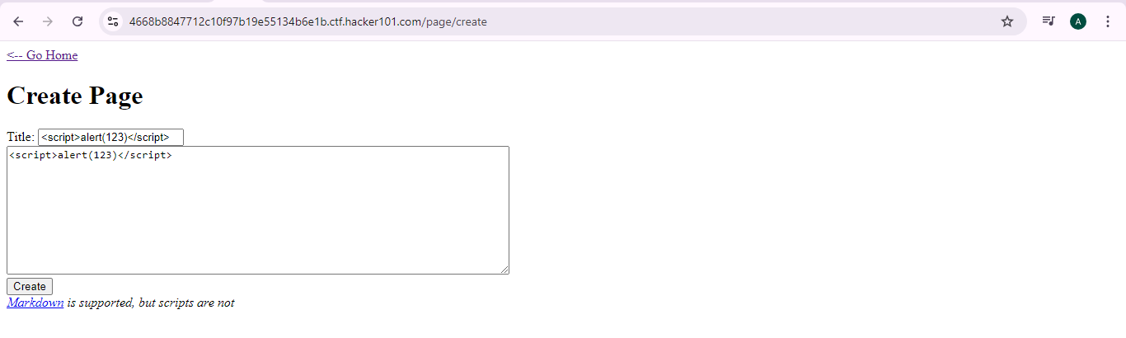
A the code in the Tittle and then click create and then click go home

Slide 21
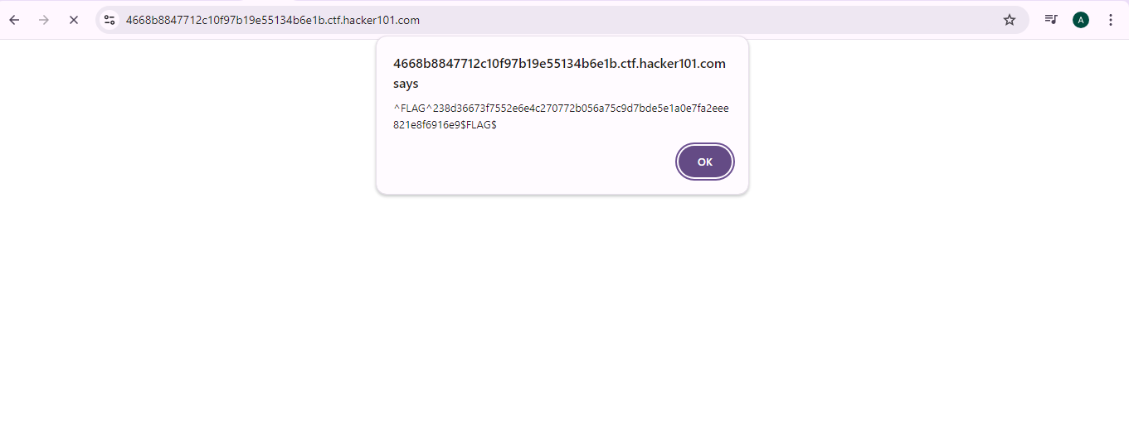
here you will get a flag lets copy it and paste it in submit a flag

Slide 22

after you paste the code click check .

